Slide 1
Bank’s Direct Marketing
Group 17
Yueze Xu
Amy Aumpansub
Wei Wei

Slide 2
Introduction
Objective
Predict whether the customers will respond the bank’s marketing campaigns by subscribing to a term deposit (y variable) based on customers’ characteristics and campaign’s attributes (predictors).
Which types of customers are more likely to respond to a bank’s campaign and subscribe a bank term deposit?
How effective is the bank’s marketing campaign based on phone calls?
Dataset
Data is related to Portuguese bank’s marketing campaigns based on phone calls.
41188 observations (collected from May 2008 to Nov 2010)
20 predictors and 1 target variable
source: UCI Machine Learning Repository
https://archive.ics.uci.edu/ml/datasets/Bank+Marketing

Slide 3
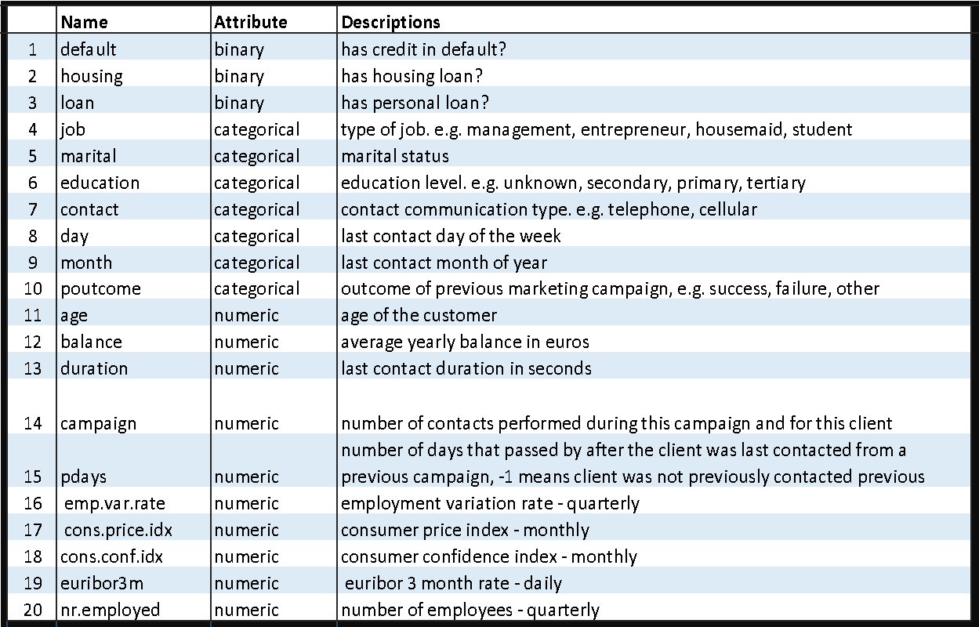
Attributes Description
Target Variable (y)
Categorical variable
Binary: ‘YES’ or ‘NO’
Has client subscribed a term deposit?
Predictors (x)
10 Categorical variable
3 Binary
10 Numeric variable
Client’s characteristics and campaign’s attributes

Slide 4
Methodology
Client’s characteristics
Campaign’s attributes
Data exploration
Data pre processing
Data cleaning
Data integration
Data transformation
Data reduction
Training set (70% of total obs)
Classification
Model Fitting
Decision Tree (All predictors)
K nearest neighbors (Numeric)
Model evaluation & comparison
KNN
Decision Tree
Classifier
Yes/No
Will client subscribe a term deposit?

Slide 5
Data Exploration

Slide 6
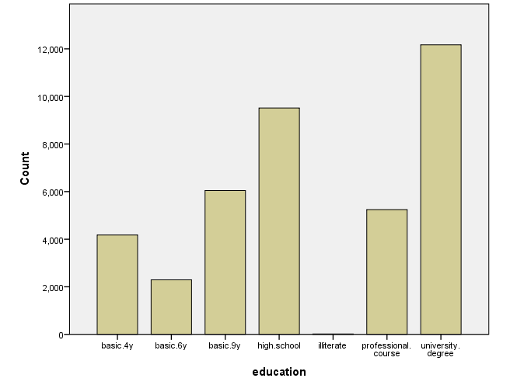
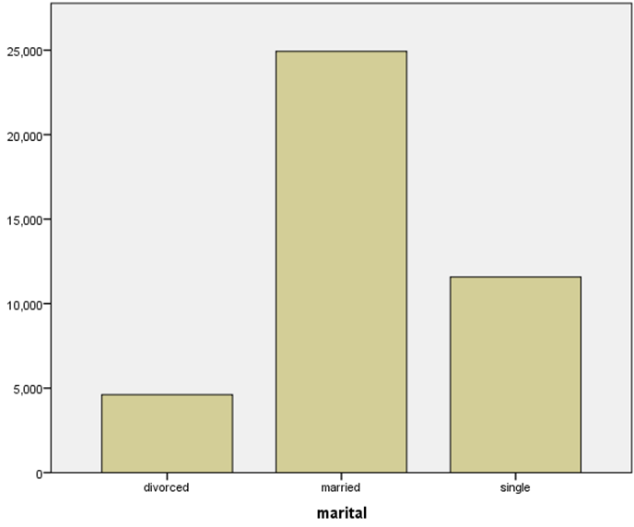
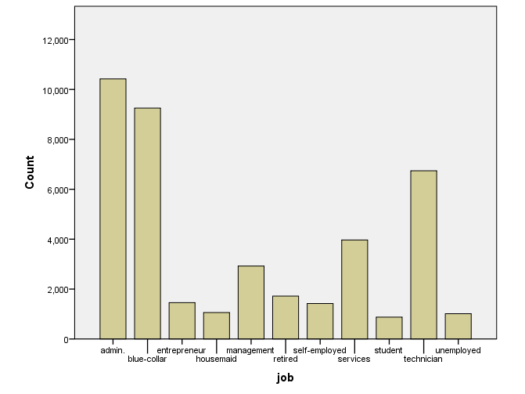
Consumer Profile
Education
29.5% University degree
23.1% High school
12.7% Professional course
Marital Status
60.5% Married
28.1% Single
11.2% Divorced
Job
25.3% Admin
22.5% Blue-collar
16.4% Technician

Slide 7
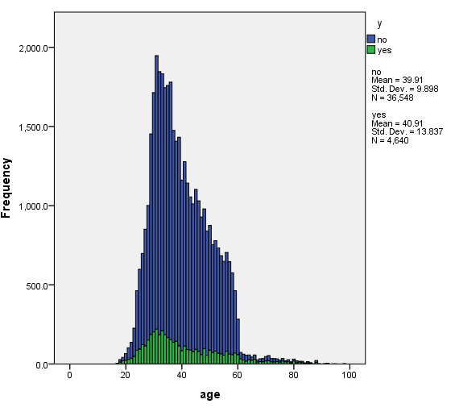
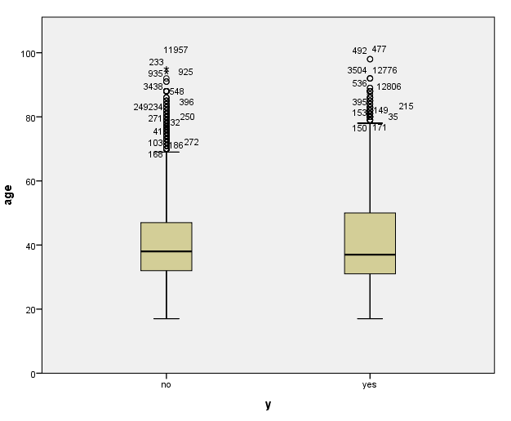
Consumer Profile (Con’t)
Age
Range 17 - 98 yrs old
40.2 % (28-37 yrs old)
28.0% (38-47 yrs old)
18.6% (48-57 yrs old)
Age vs Target Variable
Skewed right
Contains many outliers
Median 40 yrs old

Slide 8
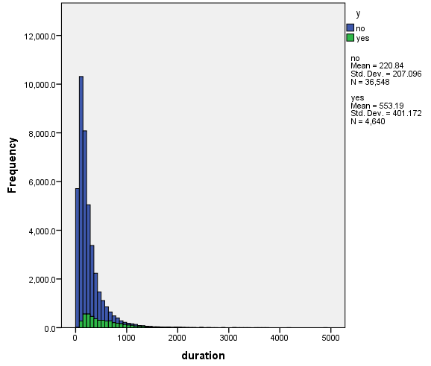
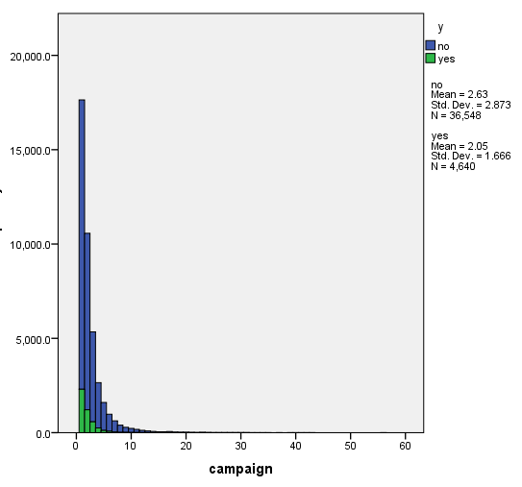
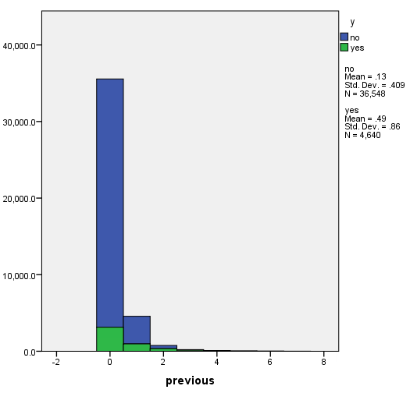
Target variable vs Campaign Attributes
Duration Campaign Previous
Last contact duration in sec.
Range: 0-4918 secs
Mean: 258.29 secs
Mode: 85 secs
Number of contacts performed
during this campaign
Range: 1-56 contacts
Mean: 2.57 contacts
Mode: 1 contacts
Number of contacts performed in the previous campaign
Range: 0-7contacts
Mean: 0.17 contacts
Mode: 0 contacts
Right-skewed distribution
96.3% of the client never got contacted for the previous campaign

Slide 9
Data Preprocessing

Slide 10
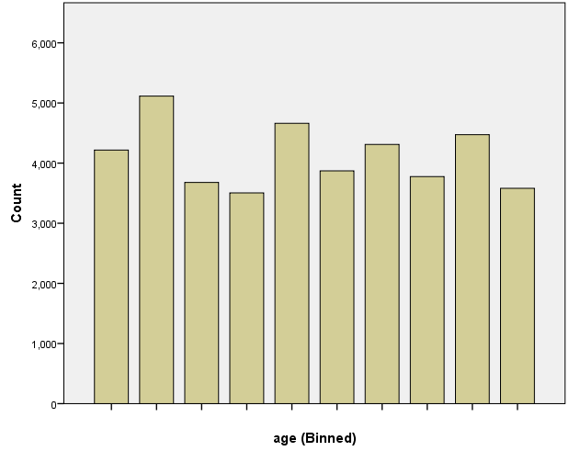
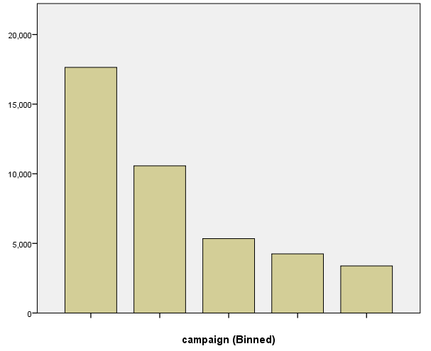
Data Preprocessing
Binned Age
Data Cleaning
Missing Values
Fill in the missing values of categorical variables (0.7% total samples) with the class label “Unknown”.
No missing values for numeric variables
Outliers
Calculate Z-scores for 10 numeric variables
Pdays and Previous contains a large Z-score as most clients didn’t get a contact before
Age, Campaign, Duration, Pdays, Previous variables contain outliers with absolute z-score > 3.
Data Transformation
Binning (Equal Frequency)
Age and Duration are binned into 10 bins
Campaign is binned into 5 bins
Smoothing by the mean and named new variable
Binned Campaign

Slide 11
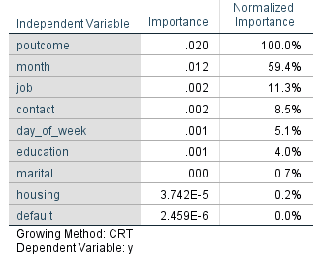
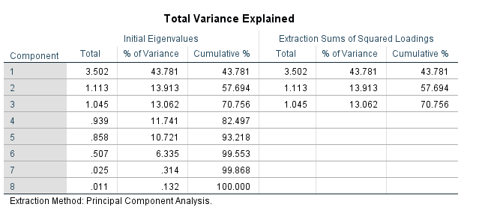
Data Reduction
Categorical Variables
Attribute Selection ⟶ Decision Tree
Run decision tree for 10 categorical variables
The most 3 important variables are:
Poutcome (Success/Fail), Month, Job
Reduced set contains 6 attribute :
Poutcome, Month, Job, Contact, Day of Week, and Education
Attribute Extraction ⟶ PCA
Standardize all 8 numerical variables to remove a scale effect
Run PCA for standardized variables (z-variables)
3 Principal Components
Explain 70.75% of total variance
Numeric Variables

Slide 12
Model Fitting
( Decision Tree )

Slide 13
Akbar Aidarov
Decision Tree
41188 Total Observations
Training Set
70 % of total obs (Holdout Partition)
6 categorical variables and 8 numeric variables
Used to fit the classification model
Test Set
30 % of total obs
Used for model evaluation and for model comparison
Target Variable: Binary “Yes”/ “No”
(Will client subscribe the deposit ?)
Predictors: Poutcome, Month, Job, Contact, Day of Week, Education, age_mean, campaign_mean, duration_mean, emp.var.rate, cons.price.idk, cons.conf.idk, euribor3m, ny.employed

Slide 14
Decision Tree
Classification Model
CART method with Gini Index with 0.001 impurity threshold
Pre Pruning (Level of Depth: 20)
Parent nodes (100, 200, 500, 1000)
Child nodes (50, 100, 250, 500)
Post Pruning
Model (Parent, Child) | Partition | Accuracy | Sensitivity | Specificity | Precision | F Measure
(100, 50) | Train | 91.5% | 47.68% | 97.10% | 67.72% | 55.96%
 | Test | 91.3% | 46.70% | 96.90% | 64.73% | 54.26%
(200, 100) | Train | 91.3% | 46.60% | 97.00% | 66.78% | 54.90%
 | Test | 91.2% | 46.40% | 96.80% | 64.03% | 53.81%
(500, 250) | Train | 90.9% | 39.30% | 97.60% | 67.40% | 49.65%
 | Test | 91.0% | 38.60% | 97.40% | 65.10% | 48.46%
(1000, 500) | Train | 90.7% | 31.20% | 98.30% | 70.16% | 43.19%
 | Test | 90.8% | 31.20% | 98.10% | 67.46% | 42.67%
Final Model

Slide 15
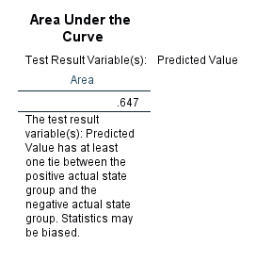
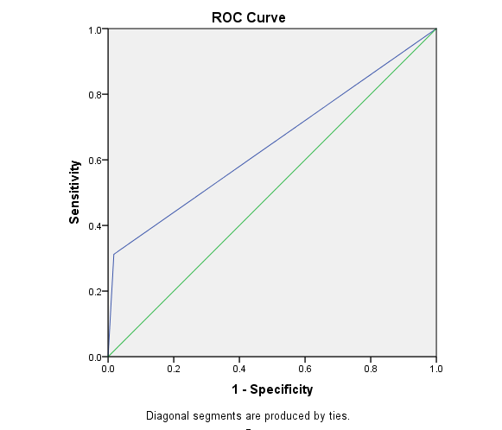
Decision Tree
ROC Cuves
From the ROC curve we get the area under the curve is .647 with 95% confidence interval.
Also, the area under the curve is significant difference from 0.5, which mean that the decision tree classifies the group significantly better than by chance

Slide 16
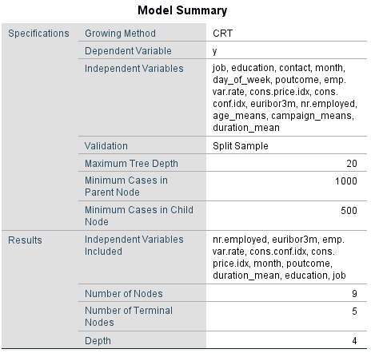
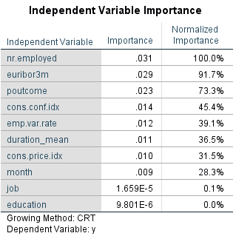
Final Model
1000 Parent nodes, 500 Children nodes, 20 Depth level
Total 9 nodes with 5 terminal nodes
Accuracy Rate ⟶ 90.7% (Train) 90.8% (Test)
Error Rate ⟶ 9.30% 9.20%
Specificity ⟶ 31.2% 31.2%
Sensitivity Rate ⟶ 98.3% 98.1%

Slide 17
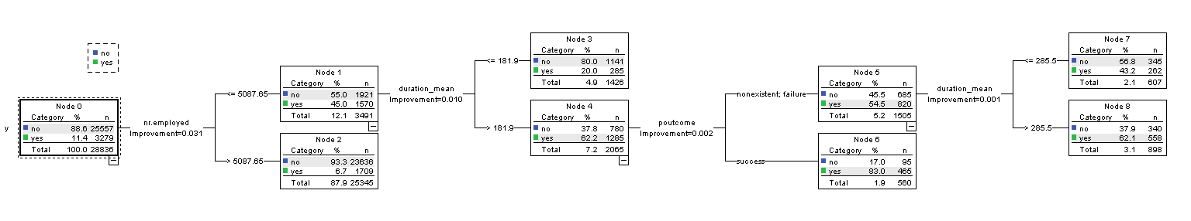
Classifiers

Slide 18
Model Fitting
( KNN)

Slide 19
K-Nearest Neighbors (KNN)
41188 Total Observations
Training Set
70 % of total obs (Holdout Partition)
8 “z-score standardized” numeric variables
Used to fit the model
Test Set
30 % of total obs
Used for model evaluation and for model comparison
Target Variable: Binary “Yes”/ “No”
(Will client subscribe the deposit ?)
Predictors: ⟶ Zage_mean, Zcampaign_mean, Zduration_mean, Zemp.var.rate, Zcons.price.idk, Zcons.conf.idk, Zeuribor3m, Zny.employed
⟶ 6 Recode Z-variables and 3 Principal Components (PCA1, PCA2, PCA3)

Slide 20
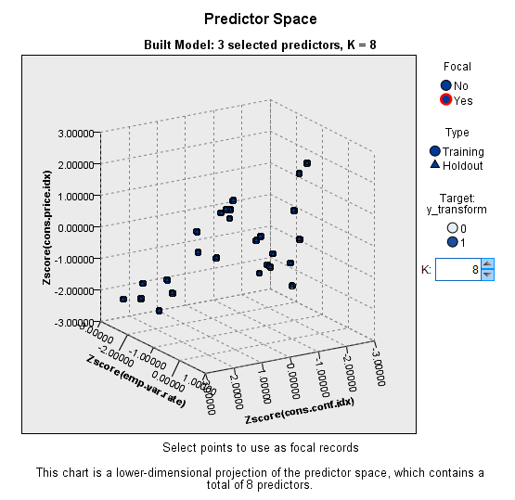
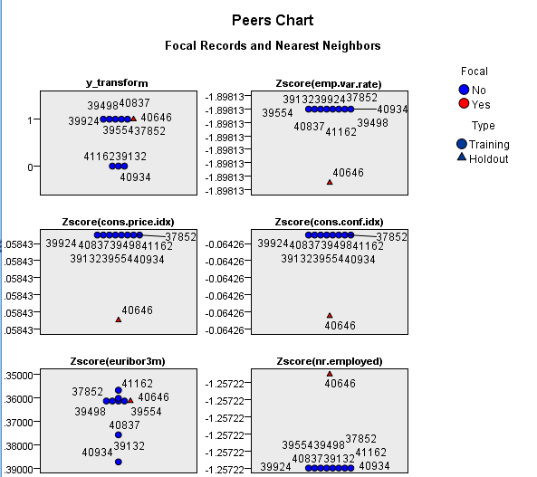
KNN 1
(8 Z-Score Numeric Variables)
Classification Model
K = 3 to 8
10 Cross-validation folds for selecting K
Euclidean Distance
Best K = 8 with lowest error rate

Slide 21
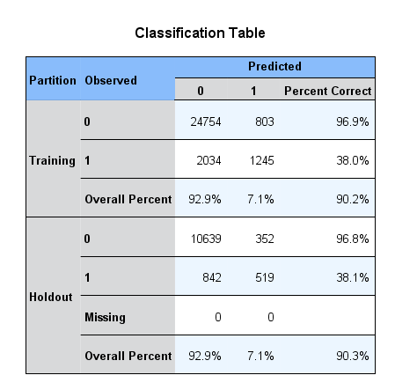
KNN 1
(8 Z- Score Numeric Variables)
Confusion Matrix (K=8)
Accuracy rate
Train: 90.2%
Test: 90.3%
Error Rate
Train: 9.8%
Test: 9.7%
Sensitivity Rate
Train: 38.0%
Test: 38.1%
Specificity Rate
Train: 96.9%
Test: 96.8%

Slide 22
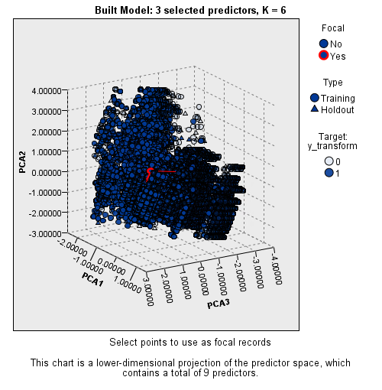
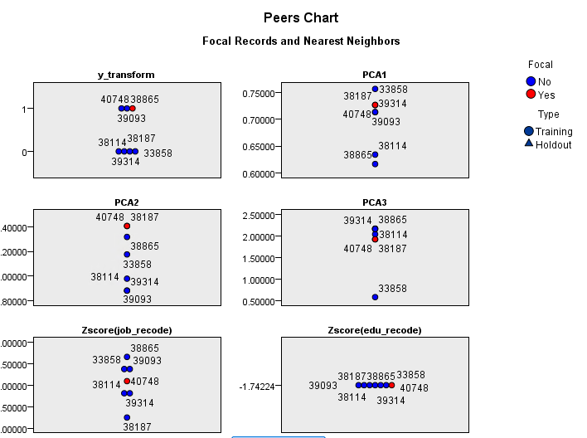
KNN 2
(6 Recoded Z-variables and 3 Principal components)
Classification Model
K = 3 to 8
10 Cross-validation folds for selecting K
Euclidean Distance
Best K = 6 with lowest error rate

Slide 23
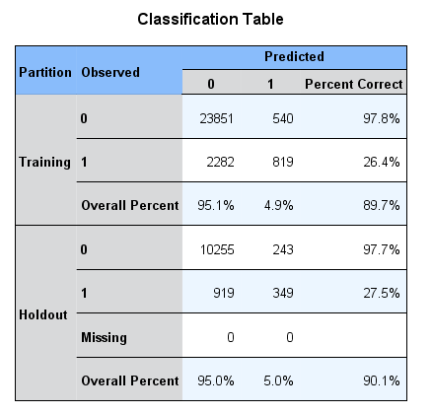
KNN 2
(6 Recoded Z-variables and 3 Principal components)
Confusion Matrix (K=6)
Accuracy rate
Train: 89.7%
Test: 90.1%
Error Rate
Train: 10.3%
Test: 9.9%
Sensitivity Rate
Train: 26.4%
Test: 27.5%
Specificity Rate
Train: 97.8%
Test: 97.7%

Slide 24
KNN Model Comparison
Model Predictors | Partition | Accuracy | Sensitivity | Specificity | Precision | F Measure
8 Numeric | Train | 90.2% | 38.00% | 96.90% | 60.79% | 46.77%
 | Test | 90.3% | 38.10% | 96.80% | 59.59% | 46.48%
Recoded Var & 3 PCA | Train | 89.7% | 26.40% | 97.80% | 60.26% | 36.72%
 | Test | 91.0% | 27.50% | 97.70% | 58.95% | 37.50%

Slide 25
Model Comparison
Decision Tree vs KNN
Model | Partition | Accuracy | Sensitivity | Specificity
Decision Tree (1000, 500) | Train | 90.7% | 31.2% | 98.3%
 | Test | 90.8% | 31.2% | 98.1%
KNN 8 numeric | Train | 90.2% | 38.0% | 96.9%
 | Test | 90.3% | 38.1% | 96.8%
We select Decision Tree Model as our final model

Slide 26
Conclusion
Bank performs a direct marketing(phone calls) to boost subscriptions for a term deposit
The Decision Tree is used to identify the most influential attributes which will help improve the effectiveness of campaign
KNN is used to predict the target variable using numeric attributes.
The most 3 important attributes are: Number of employees (economic indicator), Euribor 3 mth Rate, Outcome of previous campaign
The least important attributes are: Job and education of clients
Campaign and economic attributes have more effect on a target variable than the client’s characteristics.

Slide 27
Thanks for Listening!!

